Slide 1

Artificial Intelligence: A Modern Approach
Fourth Edition, Global Edition
Chapter 25
Deep Learning For Natural
Language Processing
© 2022 Pearson Education Ltd.

Slide 2
Outline
Word Embeddings
Recurrent Neural Networks for NLP
Sequence-to-Sequence Models
The Transformer Architecture
Pretraining and Transfer Learning
State of the art

Slide 3
Word Embeddings
Desire a representation of words that does not require manual feature engineering, but allows for generalization between related words
word embedding: a low-dimensional vector representing a word.
learned automatically from the data.
have additional properties beyond mere proximity for similar words
have proven to be a good representation for downstream language tasks (such as question answering or translation or summarization)
possible to use generic pretrained vectors
vector dictionaries include WORD2VEC, GloVe (Global Vectors), and FASTTEXT, which has embeddings for 157 languages.

Slide 4
Word Embeddings
Given a corpus of sentences with POS tags, we learn the parameters for the word embeddings and the POS tagger simultaneously
Process steps:
Choose the width w (an odd number of words, typical=5) for the prediction window to be used
Create a vocabulary of all of the unique word tokens that occur more than, say, 5 times in the training data. Denote the total number of words in the vocabulary as v.
Sort this vocabulary in any arbitrary order (perhaps alphabetically).
Choose a value d as the size of each word embedding vector.
Create a new v-by-d weight matrix called E which is randomly initialized or from pretrained vectors
Set up a neural network that outputs a part of speech label
To encode a sequence of w words into an input vector, simply look up the embedding for each word and concatenate the embedding vectors
Train the weights E and the other weight matrices W₁, W₂, and W_{out} using gradient descent.

Slide 5
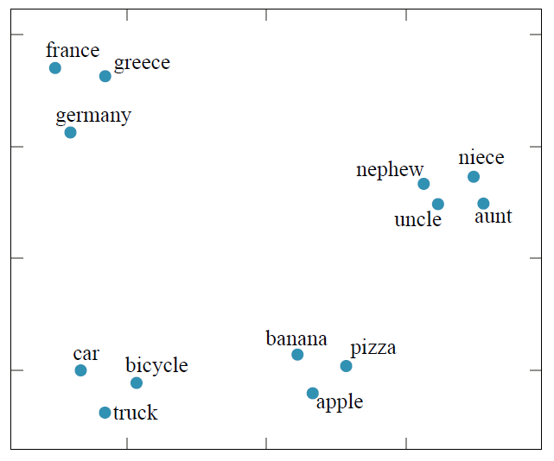
Word Embeddings
Word embedding vectors computed by the GloVe algorithm trained on 6 billion
words of text. 100-dimensional word vectors are projected down onto two dimensions in this visualization. Similar words appear near each other.

Slide 6
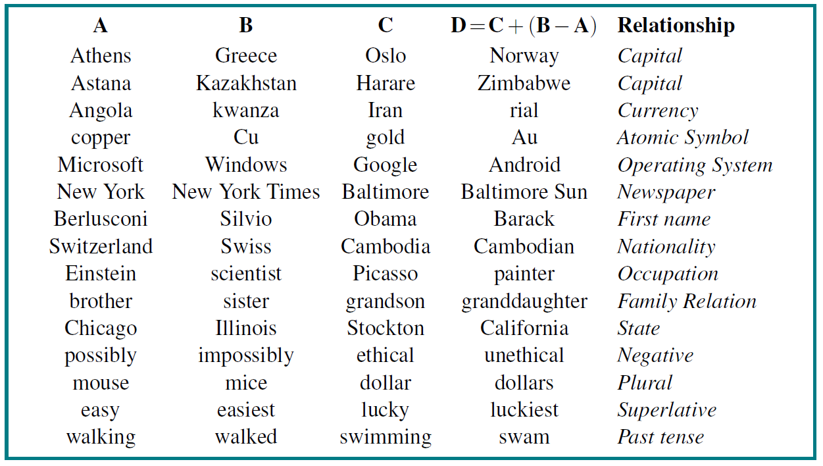
Word Embeddings
A word embedding model can sometimes answer the question “A is to B as C is to [what]?” with vector arithmetic: given the word embedding vectors for the words A, B, and C, compute the vector D = C + (B A) and look up the word that is closest to D

Slide 7
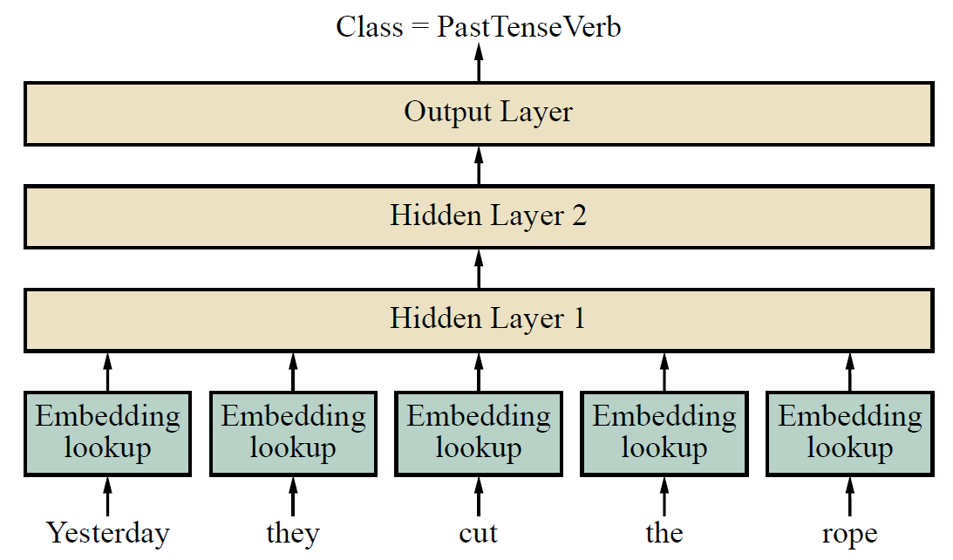
Word Embeddings
Feedforward part-of-speech tagging model. This model takes a 5-word window as input and predicts the tag of the word in the middle—here, cut. The model is able to account for word position because each of the 5 input embeddings is multiplied by a different part of the first hidden layer. The parameter values for the word embeddings and for the three layers are all learned simultaneously during training.

Slide 8
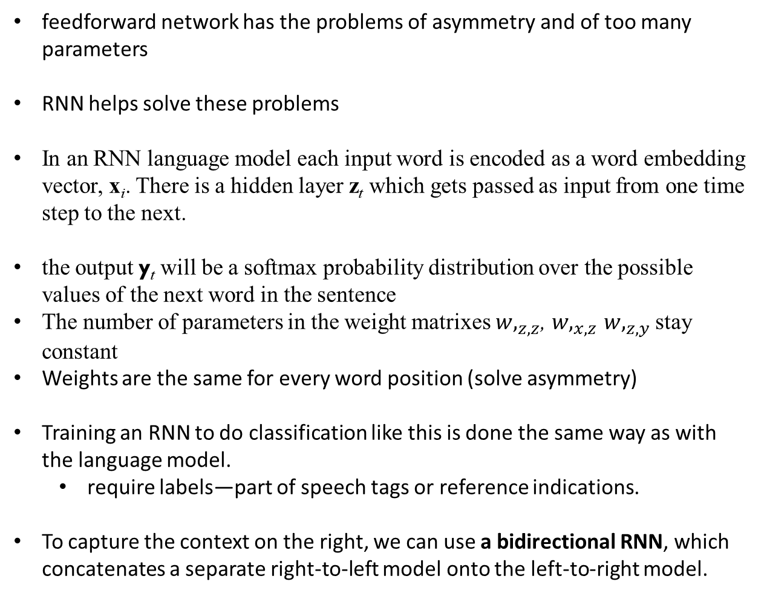
Recurrent Neural Networks for NLP
feedforward network has the problems of asymmetry and of too many parameters
RNN helps solve these problems
In an RNN language model each input word is encoded as a word embedding vector, x_{i}. There is a hidden layer z_{t} which gets passed as input from one time step to the next.
the output y_{t} will be a softmax probability distribution over the possible values of the next word in the sentence
The number of parameters in the weight matrixes ${w,}_{z,z}$, ${w,}_{x,z}$ ${w,}_{z,y}$ stay constant
Weights are the same for every word position (solve asymmetry)
Training an RNN to do classification like this is done the same way as with the language model.
require labels—part of speech tags or reference indications.
To capture the context on the right, we can use a bidirectional RNN, which concatenates a separate right-to-left model onto the left-to-right model.

Slide 9
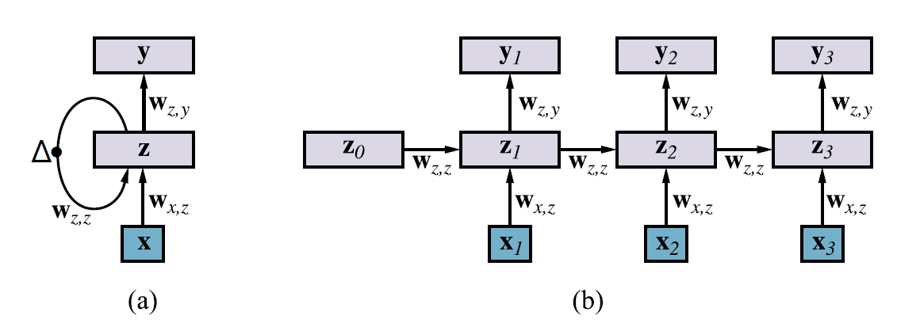
Recurrent Neural Networks for NLP
Schematic diagram of an RNN where the hidden layer z has recurrent connections; the ∆ symbol indicates a delay.
The same network unrolled over three timesteps to create a feedforward network

Slide 10
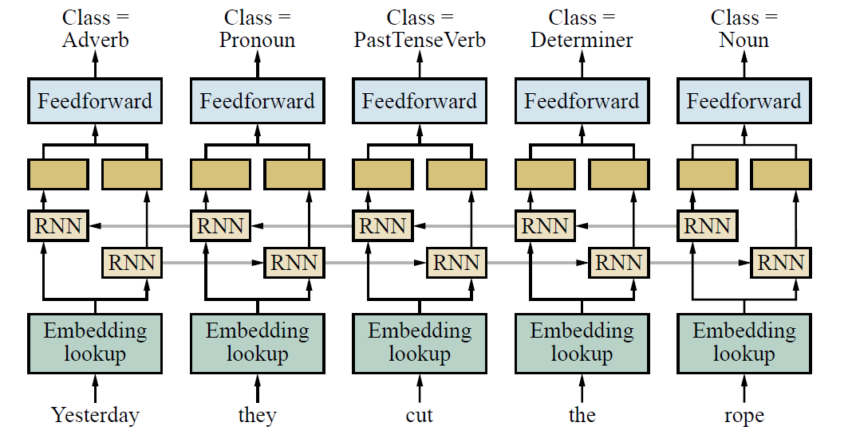
Recurrent Neural Networks for NLP
A bidirectional RNN network for POS tagging.

Slide 11
Recurrent Neural Networks for NLP
LSTMs for NLP tasks
long short-term memory (LSTM), form of RNN with gating units
don’t suffer from the problem of imperfectly reproducing a message from one time step to the next
choose to remember some parts of the input, copying it over to the next timestep, and to forget other parts
can learn to create a latent feature
`copy feature forward without alteration until it is needed to make a choice

Slide 12
Sequence-to-Sequence Models
Machine translation (MT) goal: to translate a sentence from a source language to a target language (eg: Spanish to English)
Sequence-to-sequence model
Use two RNNs, one for the source and one for the target.
Run the source RNN over the source sentence and then use the final hidden state from the source RNN as the initial hidden state for the target RNN.
Target word is implicitly conditioned on both the entire source sentence and the previous target words.
Used for translation, automatically generating text caption, summarization of image, rewriting long text to shorter ones.
Major weaknesses:
Nearby context bias
Fixed context size limit
Slower sequential processing

Slide 13
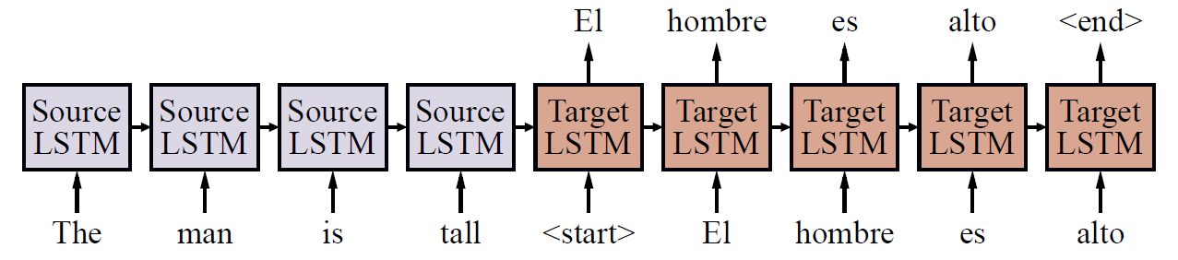
Recurrent Neural Networks for NLP
Basic sequence-to-sequence model. Each block represents one LSTM timestep.
(For simplicity, the embedding and output layers are not shown.)

Slide 14
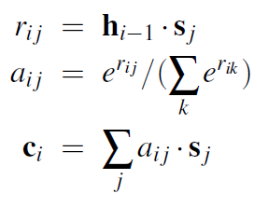
Sequence-to-Sequence Models
Attention
when the target RNN is generating the target one word at a time, it is likely that only a small part of the source is actually relevant to each target word
the target RNN must pay attention to different parts of the source for every word.
h_{i} = RNN(h_{i−1}, [x_{i}; c_{i}])
h_{i−1} is the target RNN vector, predicting at timestep, i, and s _{j} is the output of the source RNN vector for the source word (or timestep) j. Both h_{i−1} and s _{j} are d-dimensional vectors, where d is the hidden size. The value of r_{i} _{j} is therefore the raw “attention score” between the current target state and the source word j. These scores are then normalized into a probability a_{i} _{j} using a softmax over all source words. c_{i} is the weighted average of the source RNN vectors,

Slide 15
Sequence-to-Sequence Models
Decoding
our goal is to generate the corresponding target sentence
generate the target one word at a time, and then feed back in the word that we generated at the next timestep.
Greedy decoding
select the highest probability word at each timestep and then feed this word as input to the next timestep
may not achieve maximizing the probability of the entire target sequence
better approach is to search for an optimal decoding
Beam search
For MT decoding, keeps the top k hypotheses at each stage, extending each by one word using the top k choices of words,
chooses the best k of the resulting k² new hypotheses.
When all hypotheses in the beam generate the algorithm outputs the highest scoring hypothesis
state-of-the-art neural MT models use a beam size of 4 to 8, (older >100)

Slide 16
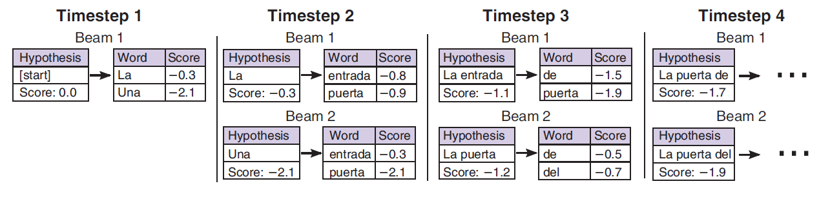
Sequence-to-Sequence Models
Beam search with beam size of b = 2. The score of each word is the log- probability generated by the target RNN softmax, and the score of each hypothesis is the sum of the word scores. At timestep 3, the highest scoring hypothesis La entrada can only generate low-probability continuations, so it “falls off the beam.”

Slide 17
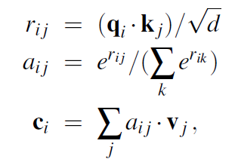
The Transformer Architecture
Self-attention
Previously attention was applied from the target RNN to the source RNN
Self-attention each sequence of hidden states attends to itself
Source to source
Target to target
Able to capture long-distance (and nearby) context within each sequence
projecting the input into three different representations using three different weight matrices
query vector q_{i} = W_{q}x_{i} the one being attended from
key vector k_{i} = W_{k}x_{i} the one being attended to
value vector v_{i} = W_{v}x_{i} the context that is being generated
,

Slide 18
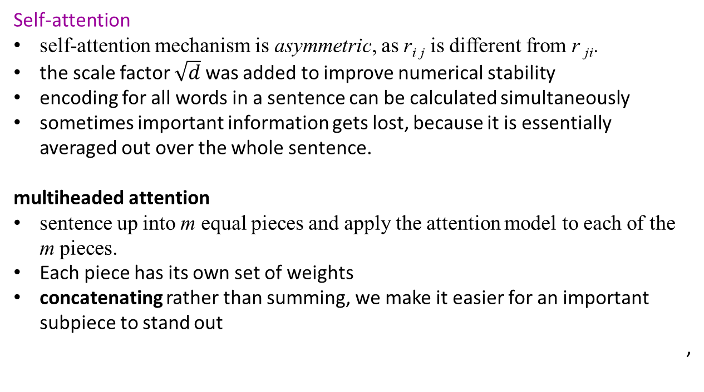
The Transformer Architecture
Self-attention
self-attention mechanism is asymmetric, as r_{i} _{j} is different from r _{ji}.
the scale factor $\sqrt{d}$ was added to improve numerical stability
encoding for all words in a sentence can be calculated simultaneously
sometimes important information gets lost, because it is essentially averaged out over the whole sentence.
multiheaded attention
sentence up into m equal pieces and apply the attention model to each of the m pieces.
Each piece has its own set of weights
concatenating rather than summing, we make it easier for an important subpiece to stand out
,

Slide 19
The Transformer Architecture
From self-attention to transformer
Each transformer layer consists of several sub-layers
Transformer encoder:
self-attention is applied first.
The output of the attention module is fed through feedforward layers, where the same feedforward weight matrices are applied independently at each position nonlinear activation function, typically ReLU, is applied after the first feedforward layer.
two residual connections are added into the transformer layer.
Usually have six or more layers
Transformer does not explicitly capture the order of words. Self attention is agnostic to word order
Positional embeddings helps to capture ordering
our input sequence has a maximum length of n, then we learn n new embedding vectors—one for each word position
Transformer decoder is nearly identical
Decoder uses version of self-attention where each word can only attend to the words before it

Slide 20
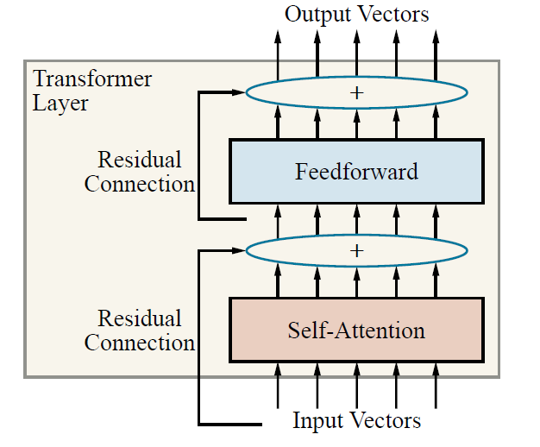
The Transformer Architecture
A single-layer transformer consists of self-attention, a feedforward network, and residual connections

Slide 21
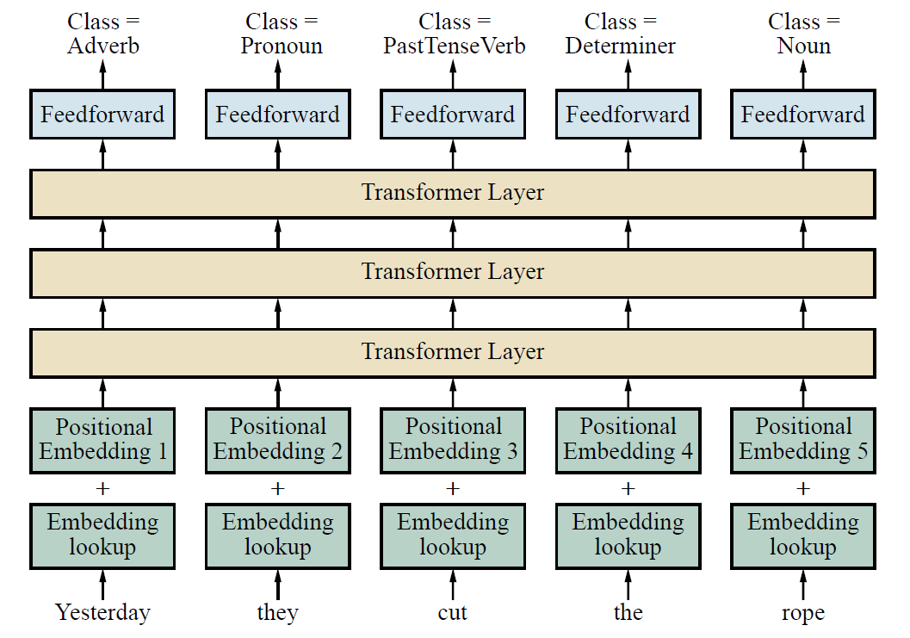
The Transformer Architecture
Using the transformer architecture for POS tagging

Slide 22
Pretraining and Transfer Learning
Pretrained word embeddings
GloVe (Global Vectors) model
specific model for word embeddings
relationship between two words can best be captured by comparing them both to other words
starts by gathering counts of how many times each word appears within a window of another word, similar to the skip-gram model
choose window size (perhaps 5 words) and let X_{i} _{j} be the number of times that words i and j co-occur within a window, and let X_{i} be the number of times word i co-occurs with any other word.
Let P_{i} _{j} = X_{i} _{j}/X_{i} be the probability that word j appears in the context of word i. As before, let E_{i} be the word embedding for word i.
E_{i} · E¹_{k} = log(P_{i} _{j}) .

Slide 23
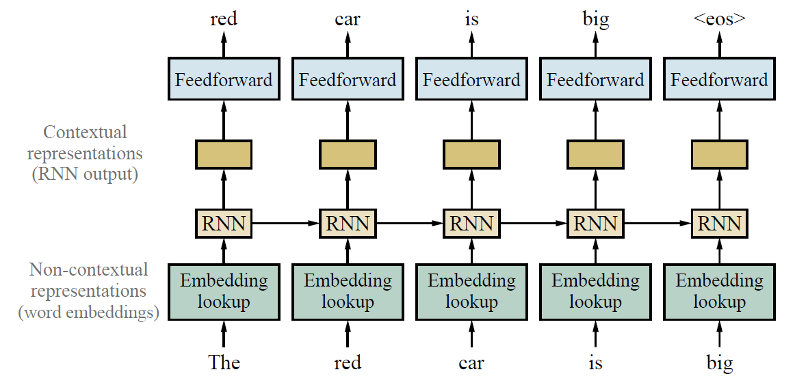
Pretraining and Transfer Learning
Pretrained contextual representations
Training contextual representations using a left-to-right language model.

Slide 24
Pretraining and Transfer Learning
Masked language models
Predictions are made from left to right but sometimes context from later in a sentence
Masked language model (MLM) are trained by masking (hiding) individual words in the input and asking the model to predict the masked words.
For this task, one can use a deep bidirectional RNN or transformer on top of the masked sentence.
The final hidden vectors that correspond to the masked tokens are then used to predict the words that were masked
During training a single sentence can be used multiple times with different words masked out.
requires no labeled data: the sentence provides its own label for the masked word.
If this model is trained on a large corpus of text, it generates pretrained representations that perform well across a wide variety of NLP tasks (machine translation, question answering, summarization, grammaticality judgments, and others)

Slide 25
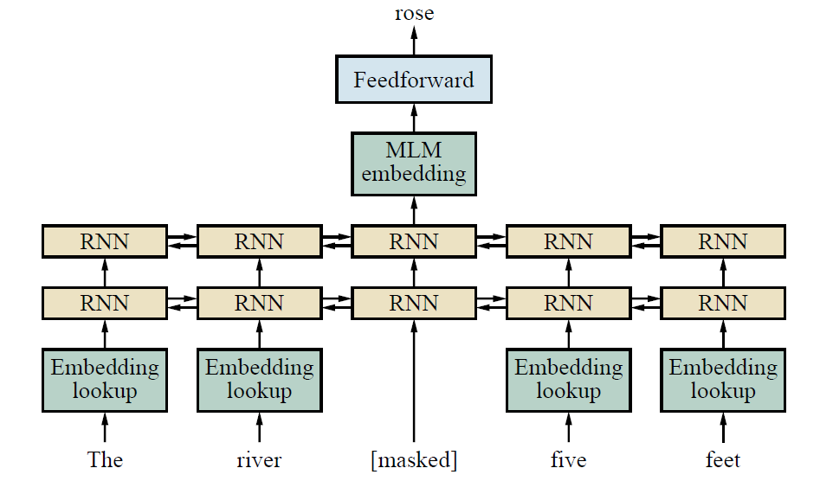
Pretraining and Transfer Learning
Masked language modeling: pretrain a bidirectional model—for example, a multilayer RNN—by masking input words and predicting only those masked words

Slide 26
State of the art
Since 2018, new NLP projects typically start with a pretrained transformer model
Although these transformer models were trained to predict the next word in a text, they do a surprisingly good job at other language tasks
A ROBERTA model with some fine-tuningachieves state-of-the-art results in question answering and reading comprehension tests
GPT-2, a transformer-like language model with 1.5 billion parameters trained on 40GB of Internet text, achieves good results on such diverse tasks as translation between French and English, finding referents of long-distance dependencies, and general-knowledge question answering, all without fine-tuning for the particular task.
ARISTO achieved a score of 91.6% on an 8th grade multiple-choice science exam. ARISTO consists of an ensemble of solvers: some use information retrieval (similar to a web search engine), some do textual entailment and qualitative reasoning, and some use large transformer language models.

Slide 27
State of the art
emergence of hybrid approaches that combine the best concepts (grammatical and semantic modeling)
SLING, parses directly into a semantic frame representation, mitigating the problem of errors building up in a traditional pipeline system.
There is certainly room for improvement: not only do NLP systems still lag human performance on many tasks, but they do so after processing thousands of times more text than any human could read in a lifetime.
This suggests that there is plenty of scope for new insights from linguists, psychologists, and NLP researchers

Slide 28
Summary
Continuous representations of words with word embeddings are more robust than discrete atomic representations, and can be pretrained using unlabeled text data.
Recurrent neural networks can effectively model local and long-distance context by retaining relevant information in their hidden-state vectors.
Sequence-to-sequence models can be used for machine translation and text generation problems.
Transformer models use self-attention and can model long-distance context as well as local context. They can make effective use of hardware matrix multiplication.
Transfer learning that includes pretrained contextual word embeddings allows models to be developed from very large unlabeled corpora and applied to a range of tasks

